Slide 1

ECG Signal Generation using Generative Adversarial Networks
Cennet Tugce Turan
Philippe Questel
M202 – Fall 2022

Slide 2
Project’s high-level goals
→ ECG signal generation on embedded systems
Use of a generative machine learning model to produce ECG signals
Use of Tiny Machine Learning to convert the model to microcontroller
Implement the model on Arduino BLE
Compare results to current literature
Expand to different types of ECG signals (healthy + pathological)

Slide 3
Motivation
Cardiovascular diseases are the leading cause of death throughout world (32.1% of deaths in 2015)
Ecg tests: effective method for diagnostics
Machine learning methods increasing 🡪 need for a lot of labeled data
Problem : lack of good ecg data + maintaining privacy for patients

Slide 4
Motivation
Acquiring large datasets to train models becomes very difficult
Solution: generate synthetic medical data without any private details.
No current solutions implemented on uC
Current generators very expensive

Slide 5
Relevant Prior Work
Debapriya et. Al – GANs for synthetic biomedical signal generation (2020)
Generator: BiLSTM
Discriminator: CNN
Fei Zhu et. Al – ECG Generation w/ a BiLSTM-CNN GAN (2019)
Generator: BiLSTM
Discriminator: CNN
Vajira Thrambawita et. al – DeepFake ECG using GANs are the beginning of the end for privacy issues in medecine (2021)
Generator: CNN
Discriminator: CNN
Novelty: no implementation on micro Controllers in the literature !

Slide 6
Technical Approach

Slide 7
Initial Dataset
« MIT-BIH Arrhythmia Database » - PhysioNet
47 subjects with 48 half-hour recordings
Digitized at 360 samples per second

Slide 8
Dataset Pre-processing
For each subject – extract a 10 second recording
Removal of the 200 gain from the signal
Resampled to 125 Hz (1200 sample signals)
From these 48 signals extract 100 sample signals + up sample to 400 samples
Final dataset: 565 400-sample recordings (a lot of unusable data).

Slide 9
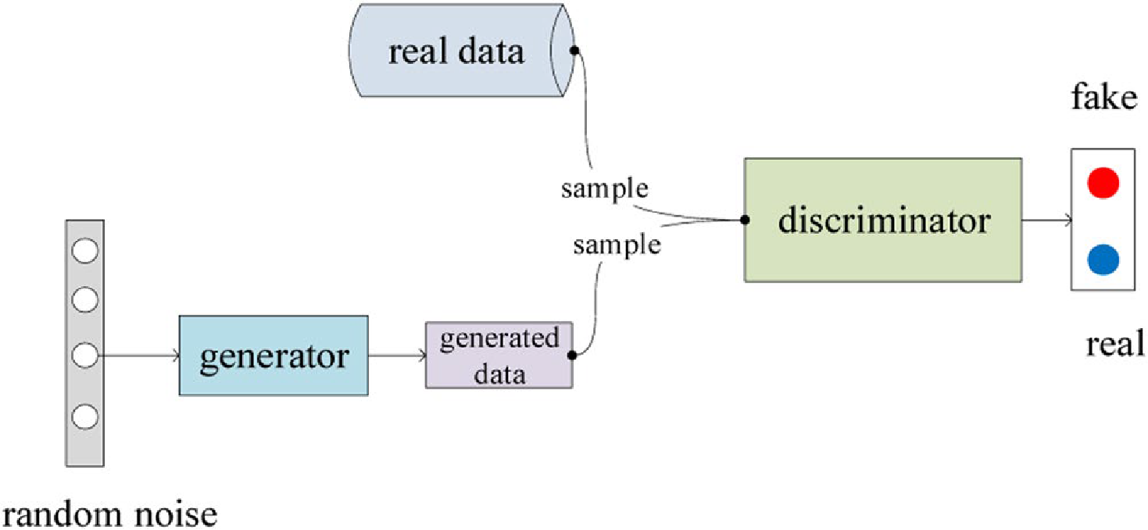
Generative Adversarial Networks
2 competing neural networks – Generator + Discriminator
Objectives
Generator: minimize log(1-D(G(z)))
Discriminator: maximize log D(x) + log (1-D(G(z))
Notes:
We will now go through how Generative Adversarial Networks work on a high-level. Like the name suggests, GANS implement two competing neural networks: a generator and a discriminator to generate synthetic data, in our case ECGs.
As we can see on the model here, the initial input to the generator is some random noise. The generator will then generate some data from the random noise and feed it into the discriminator. The discriminator will also be fed real samples from the dataset and will then try to correctly classify real data from false/generated data.
The generator will learn from the feedback of the discriminator and regenerate more synthetic data until the discriminator can no longer tell the difference between real or generated data.
So, on a high-level, the discriminator wants to maximize the probability of correctly classifying real data and the probability of correctly classifying generated data as fake (1-D(G(z)). The generator however wants to minimize the probability of the discriminator to correctly classify the generated ECGs.

Slide 10
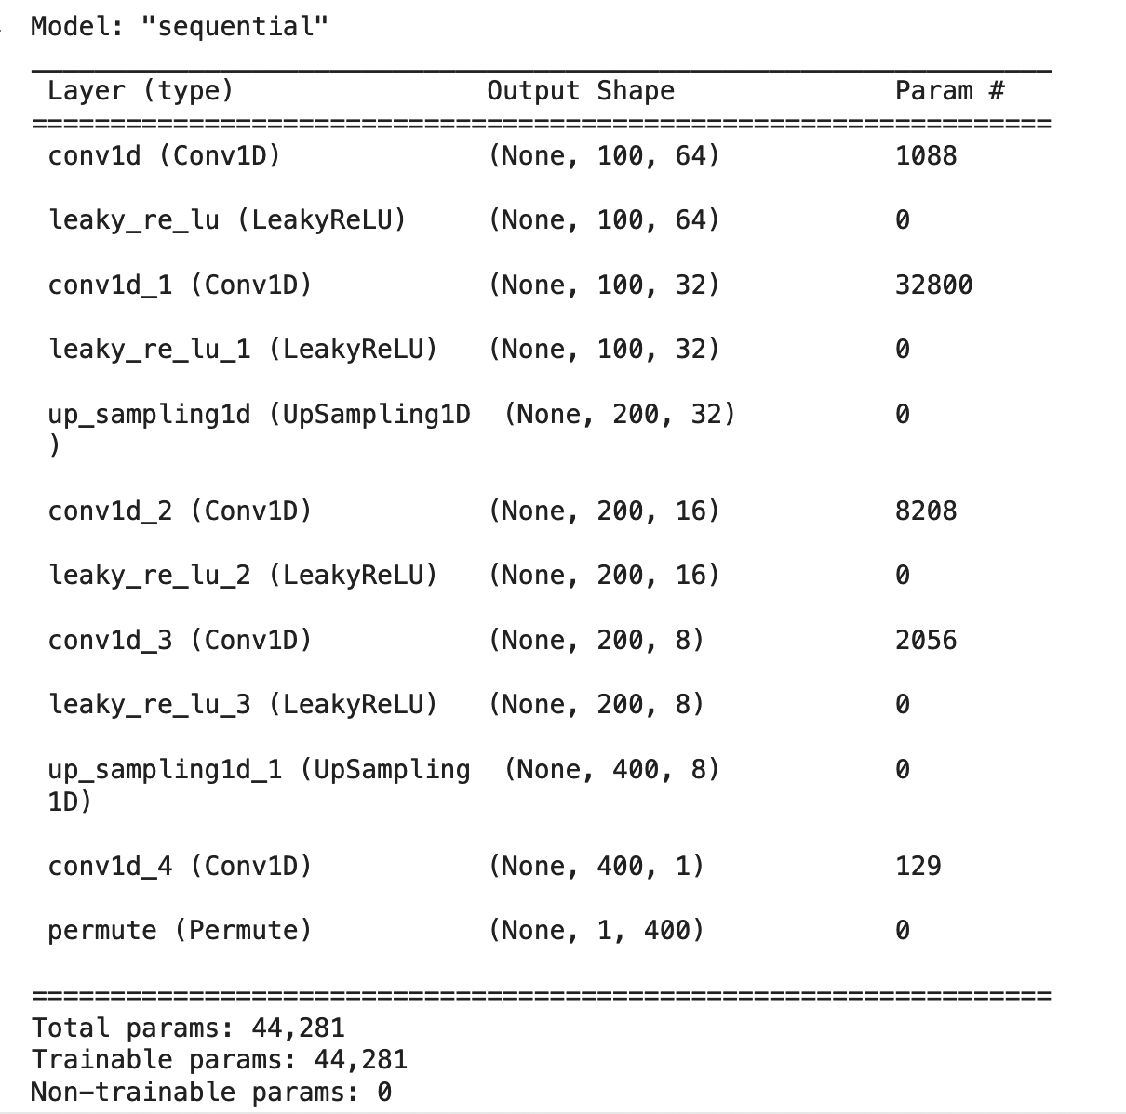
Generator Model

Slide 11
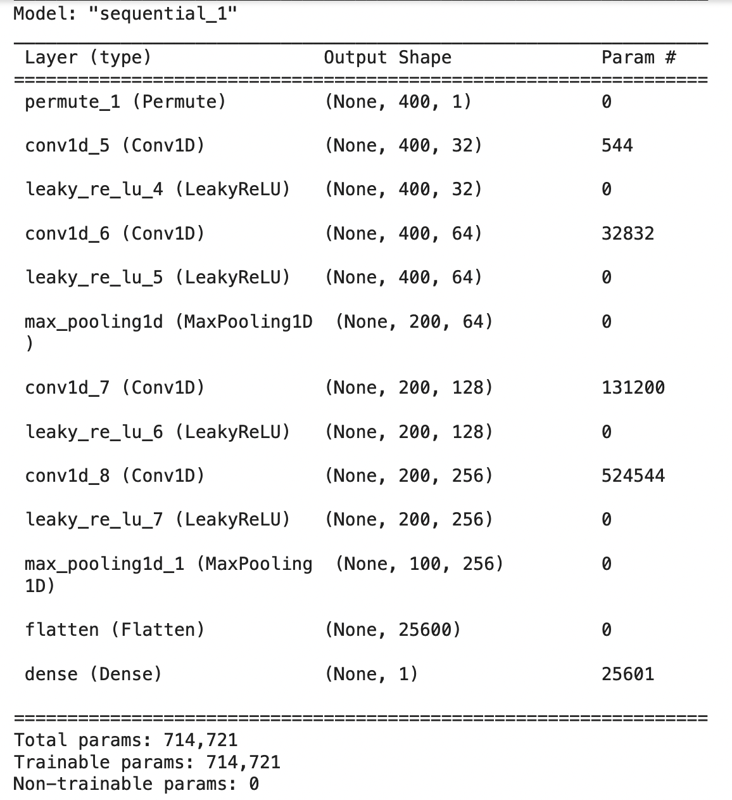
Discriminator Model

Slide 12
Training Architecture
Build the generator/discriminator
Train the dataset with variable batch size and epochs
Save generator and discriminator model
Convert generator model to TF Lite model
Compute metrics for results

Slide 13
Results & Evaluation

Slide 14
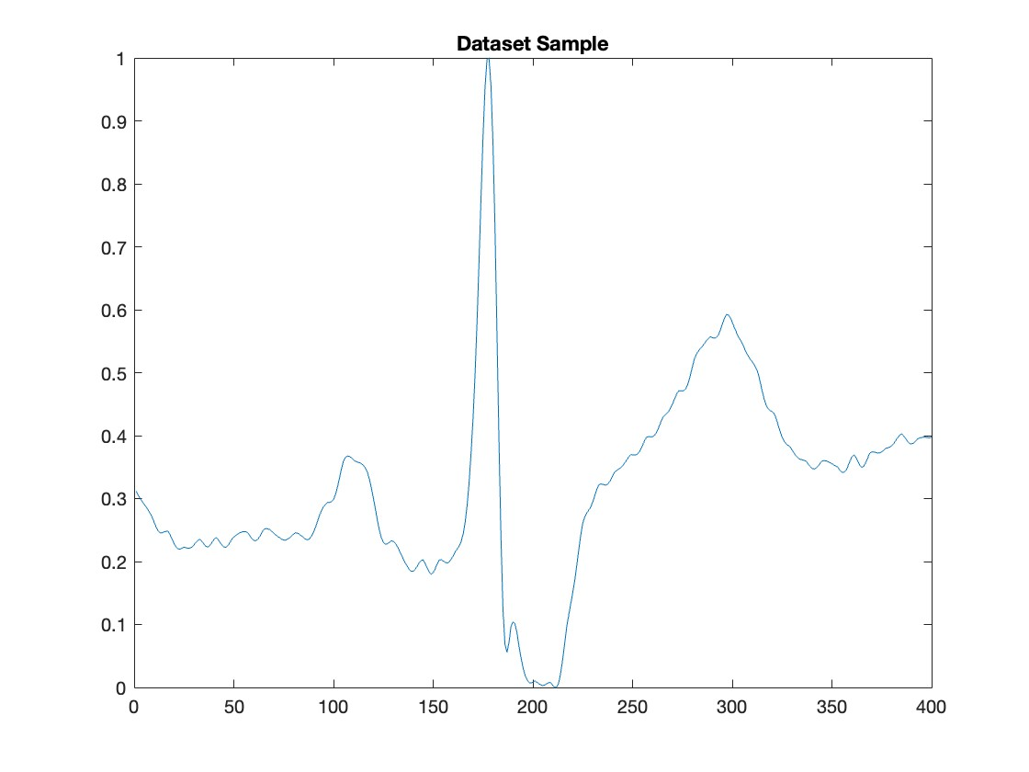
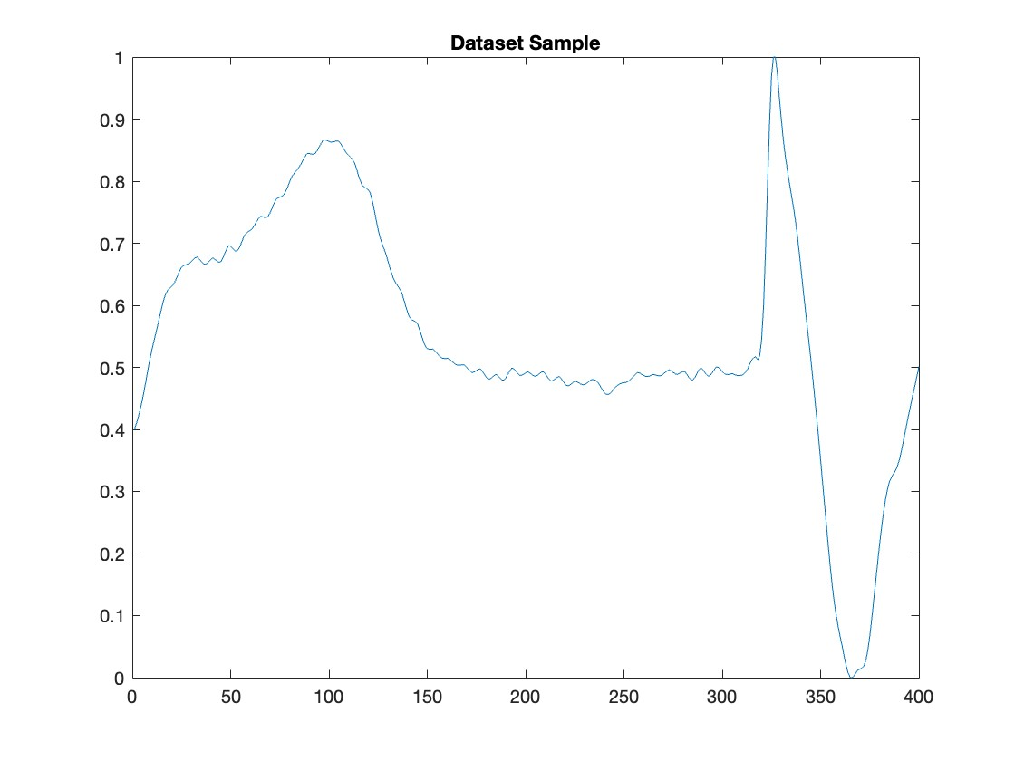
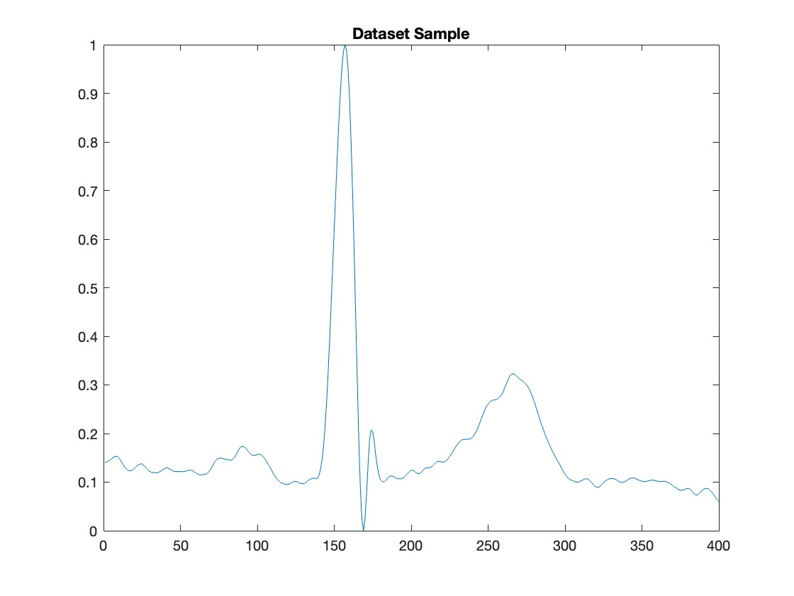
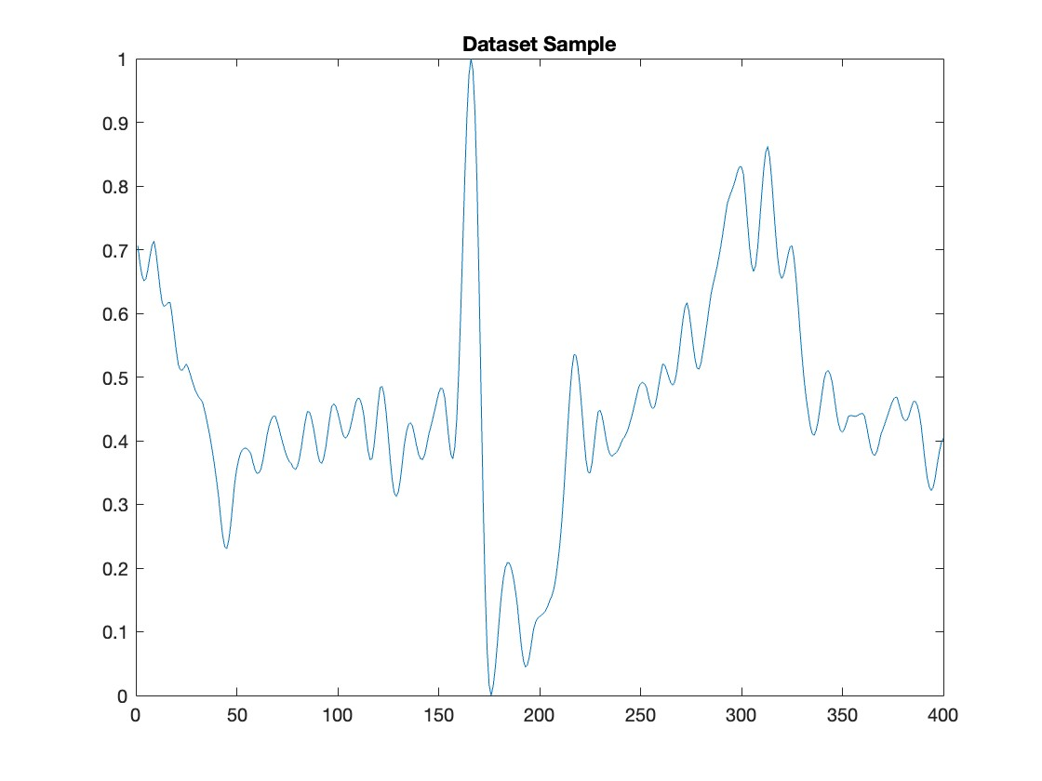
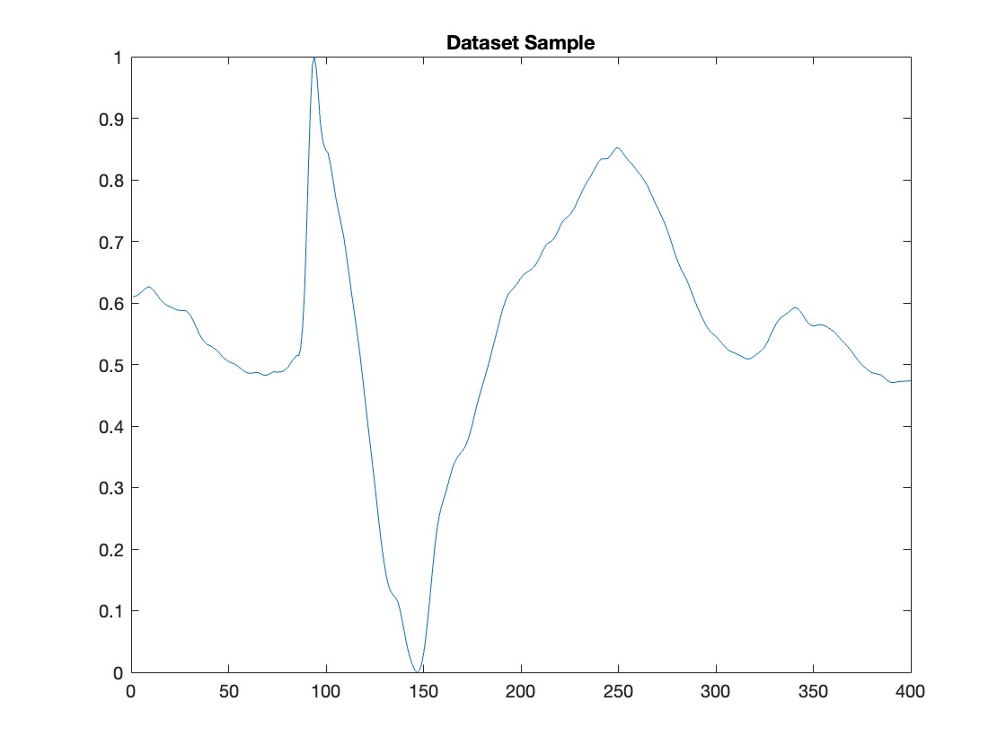
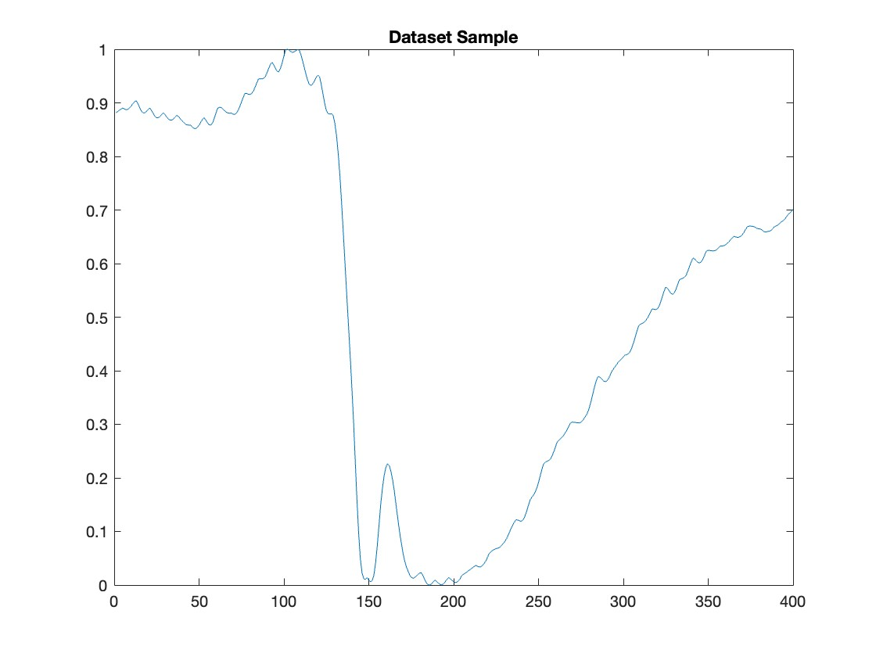
Dataset ECG recording

Slide 15
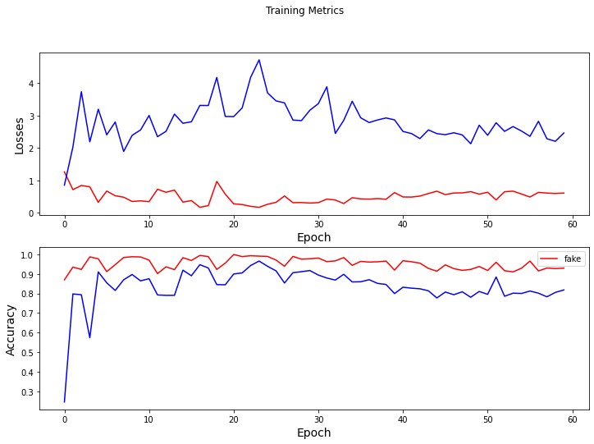
Training metrics
Discriminator Loss
Generator Loss
Fake Discriminator Accuracy
Real Discriminator
Accuracy

Slide 16
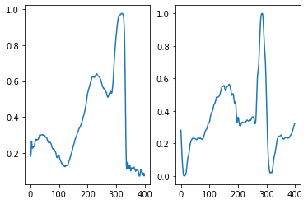
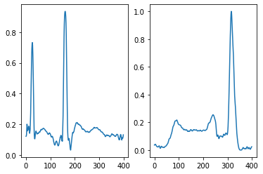
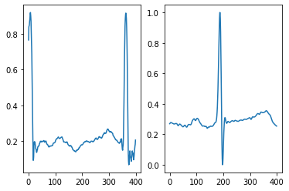
Training results
Left: generated
Right: database

Slide 17
TensorFlow Lite model
Initial Generator model size: 205.836 Kilobytes
TensorFlow Lite model size: 89.18 Kilobytes

Slide 18
Metric results
mmd (our model): mean=0.063642 min=0.000556 max=0.348375
mmd (Brophy) = 0.00103
prd (our model) : mean=11.0991 min=5.0097 max=41.8445
rmse (our model): mean=0.3165 min=0.1515 max=0.6116

Slide 19
Conclusion

Slide 20
Discussion
Current model results are satisfying but can definitely be improved
Generator model was successfully converted to an appropriate sized model for microcontroller implementation
Results still can be improved

Slide 21
Future Steps
Run the model on Arduino Nano BLE 33
Continue improving the model for better results by increasing the dataset (only 565 signals)
Train more models for different types of ECGs (healthy/pathological)
Load several models on limited memory microcontroller 🡪 Memory management

Slide 22
References
Delaney, Anne Marie, Eoin Brophy, et Tomas E. Ward. « Synthesis of Realistic ECG Using Generative Adversarial Networks ». arXiv, 19 septembre 2019. http://arxiv.org/abs/1909.09150.
Hazra, Debapriya, et Yung-Cheol Byun. « SynSigGAN: Generative Adversarial Networks for Synthetic Biomedical Signal Generation ». Biology 9, nº 12 (3 décembre 2020): 441. https://doi.org/10.3390/biology9120441.
KOCZKODAJ, Waldemar W., Jolanta MASIAK, Mirosław MAZUREK, Dominik STRZAŁKA, et Pavel F. ZABRODSKII. « Massive Health Record Breaches Evidenced by the Office for Civil Rights Data ». Iranian Journal of Public Health 48, nº 2 (février 2019): 278‑88.
Thambawita, Vajira, Jonas L. Isaksen, Steven A. Hicks, Jonas Ghouse, Gustav Ahlberg, Allan Linneberg, Niels Grarup, et al. « DeepFake Electrocardiograms Using Generative Adversarial Networks Are the Beginning of the End for Privacy Issues in Medicine ». Scientific Reports 11, nº 1 (9 novembre 2021): 21896. https://doi.org/10.1038/s41598-021-01295-2.
W. Koczkodaj, Waldemar, Jolanta Masiak, Mirosław Mazurek, Dominik Strzałka, et Pavel F. Zabrodskii. « Massive Health Record Breaches Evidenced by the Office for Civil Rights Data ». Iranian Journal of Public Health, 11 mai 2019. https://doi.org/10.18502/ijph.v48i2.826.
Zhu, Fei, Fei Ye, Yuchen Fu, Quan Liu, et Bairong Shen. « Electrocardiogram Generation with a Bidirectional LSTM-CNN Generative Adversarial Network ». Scientific Reports 9, nº 1 (décembre 2019): 6734. https://doi.org/10.1038/s41598-019-42516-z.
https://github.com/MikhailMurashov/ecgGAN

